Slide 1
Lecture – 13

Slide 2
Feedback
The usefulness of a pipeline processor can be enhanced by including feedback paths from the stage outputs to the primary inputs of the processor.
It enables the results computed by certain stages to be used in subsequent calculations.

Slide 3
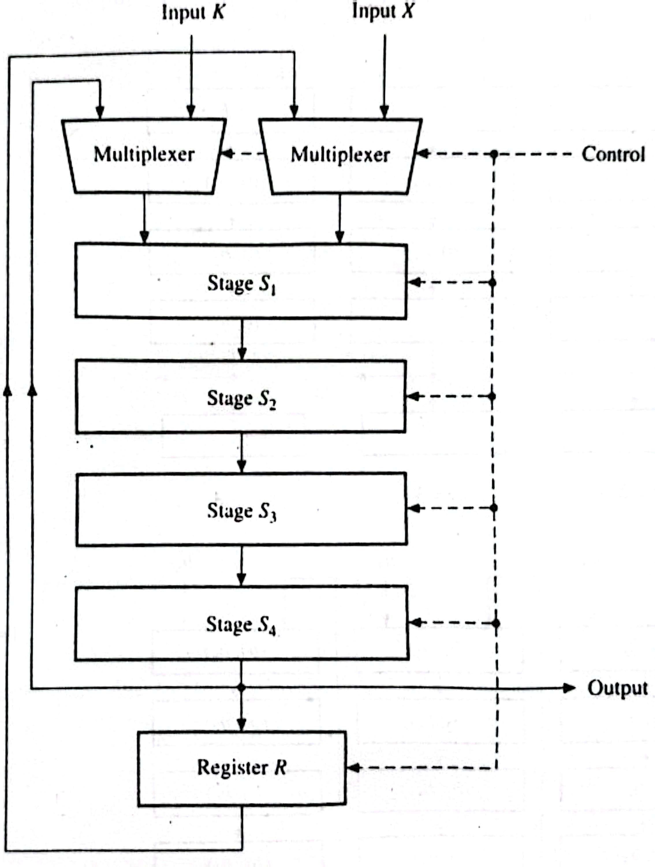
Summation by a Pipeline Processor
Consider the problem of computing the sum of N floating-point numbers b₁, b₂, …….., b_{N}.
X = Obtained from a CPU register or a memory location.
K = all-0 words.

Slide 4
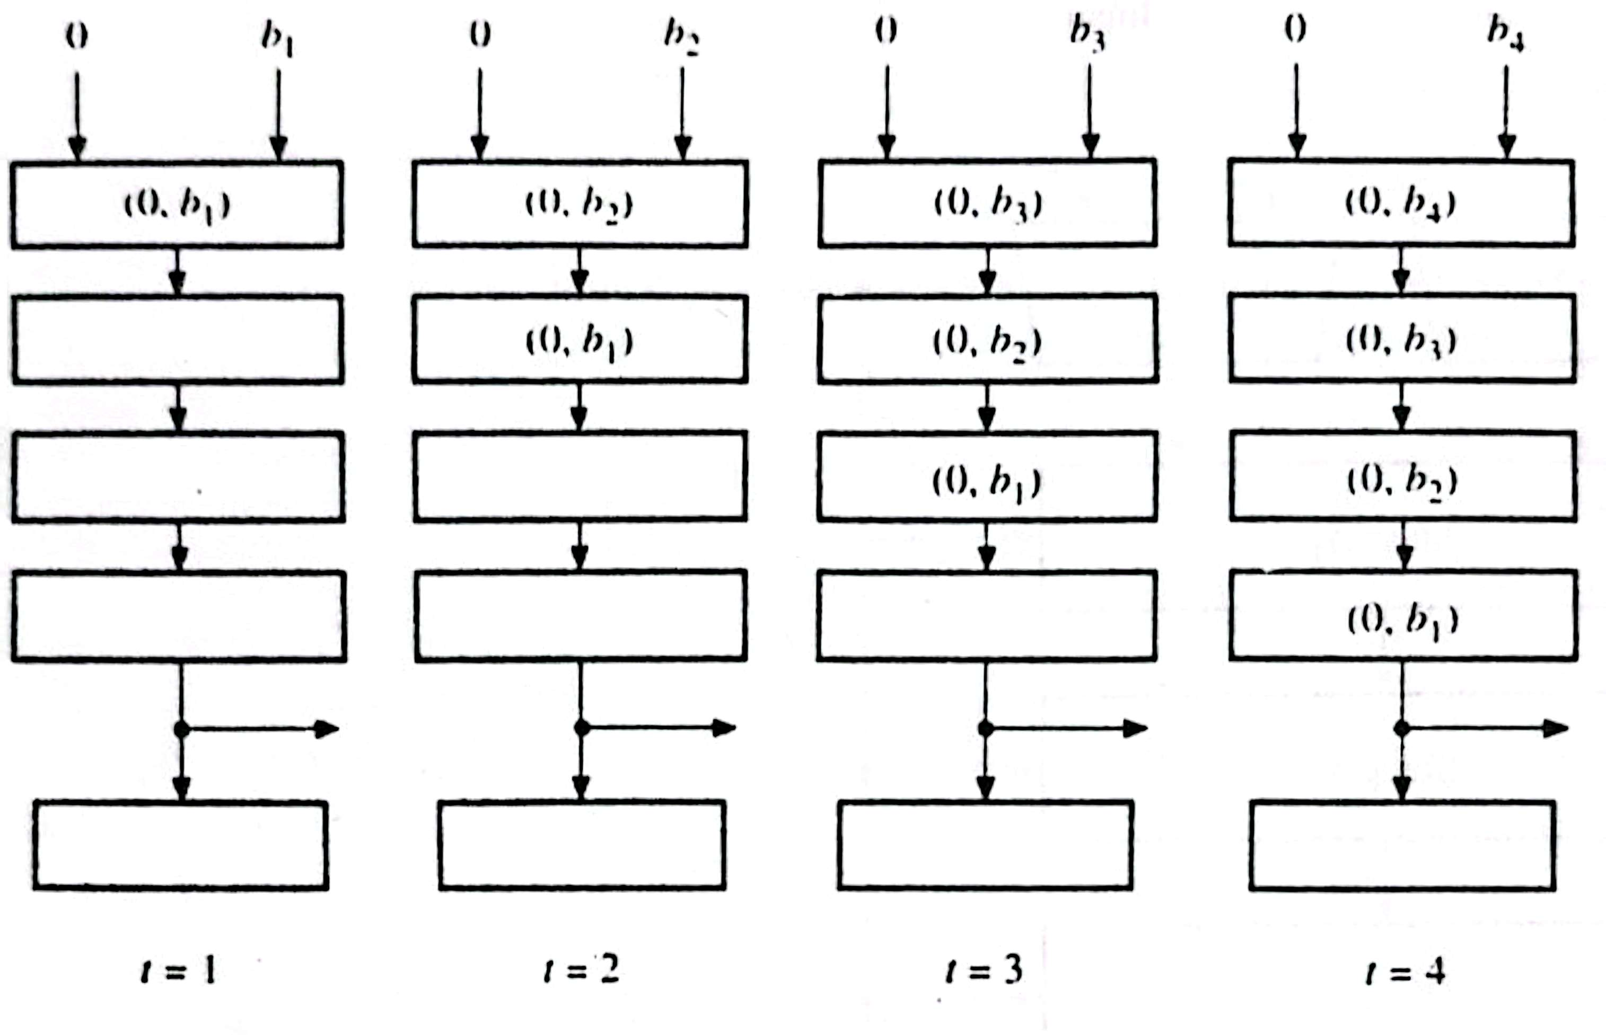
Summation by a Pipeline Processor

Slide 5
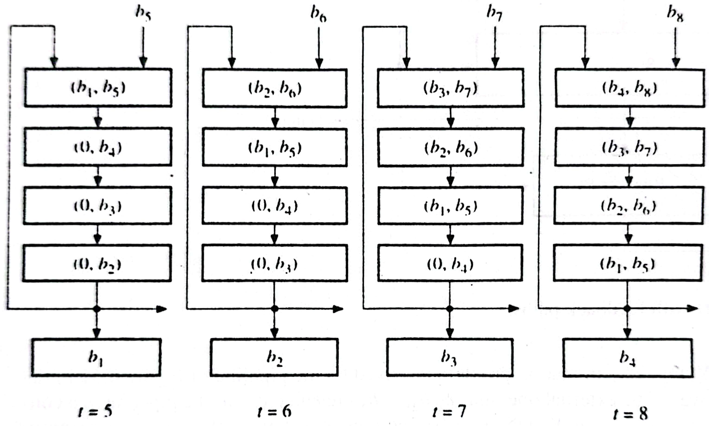
Summation by a Pipeline Processor

Slide 6
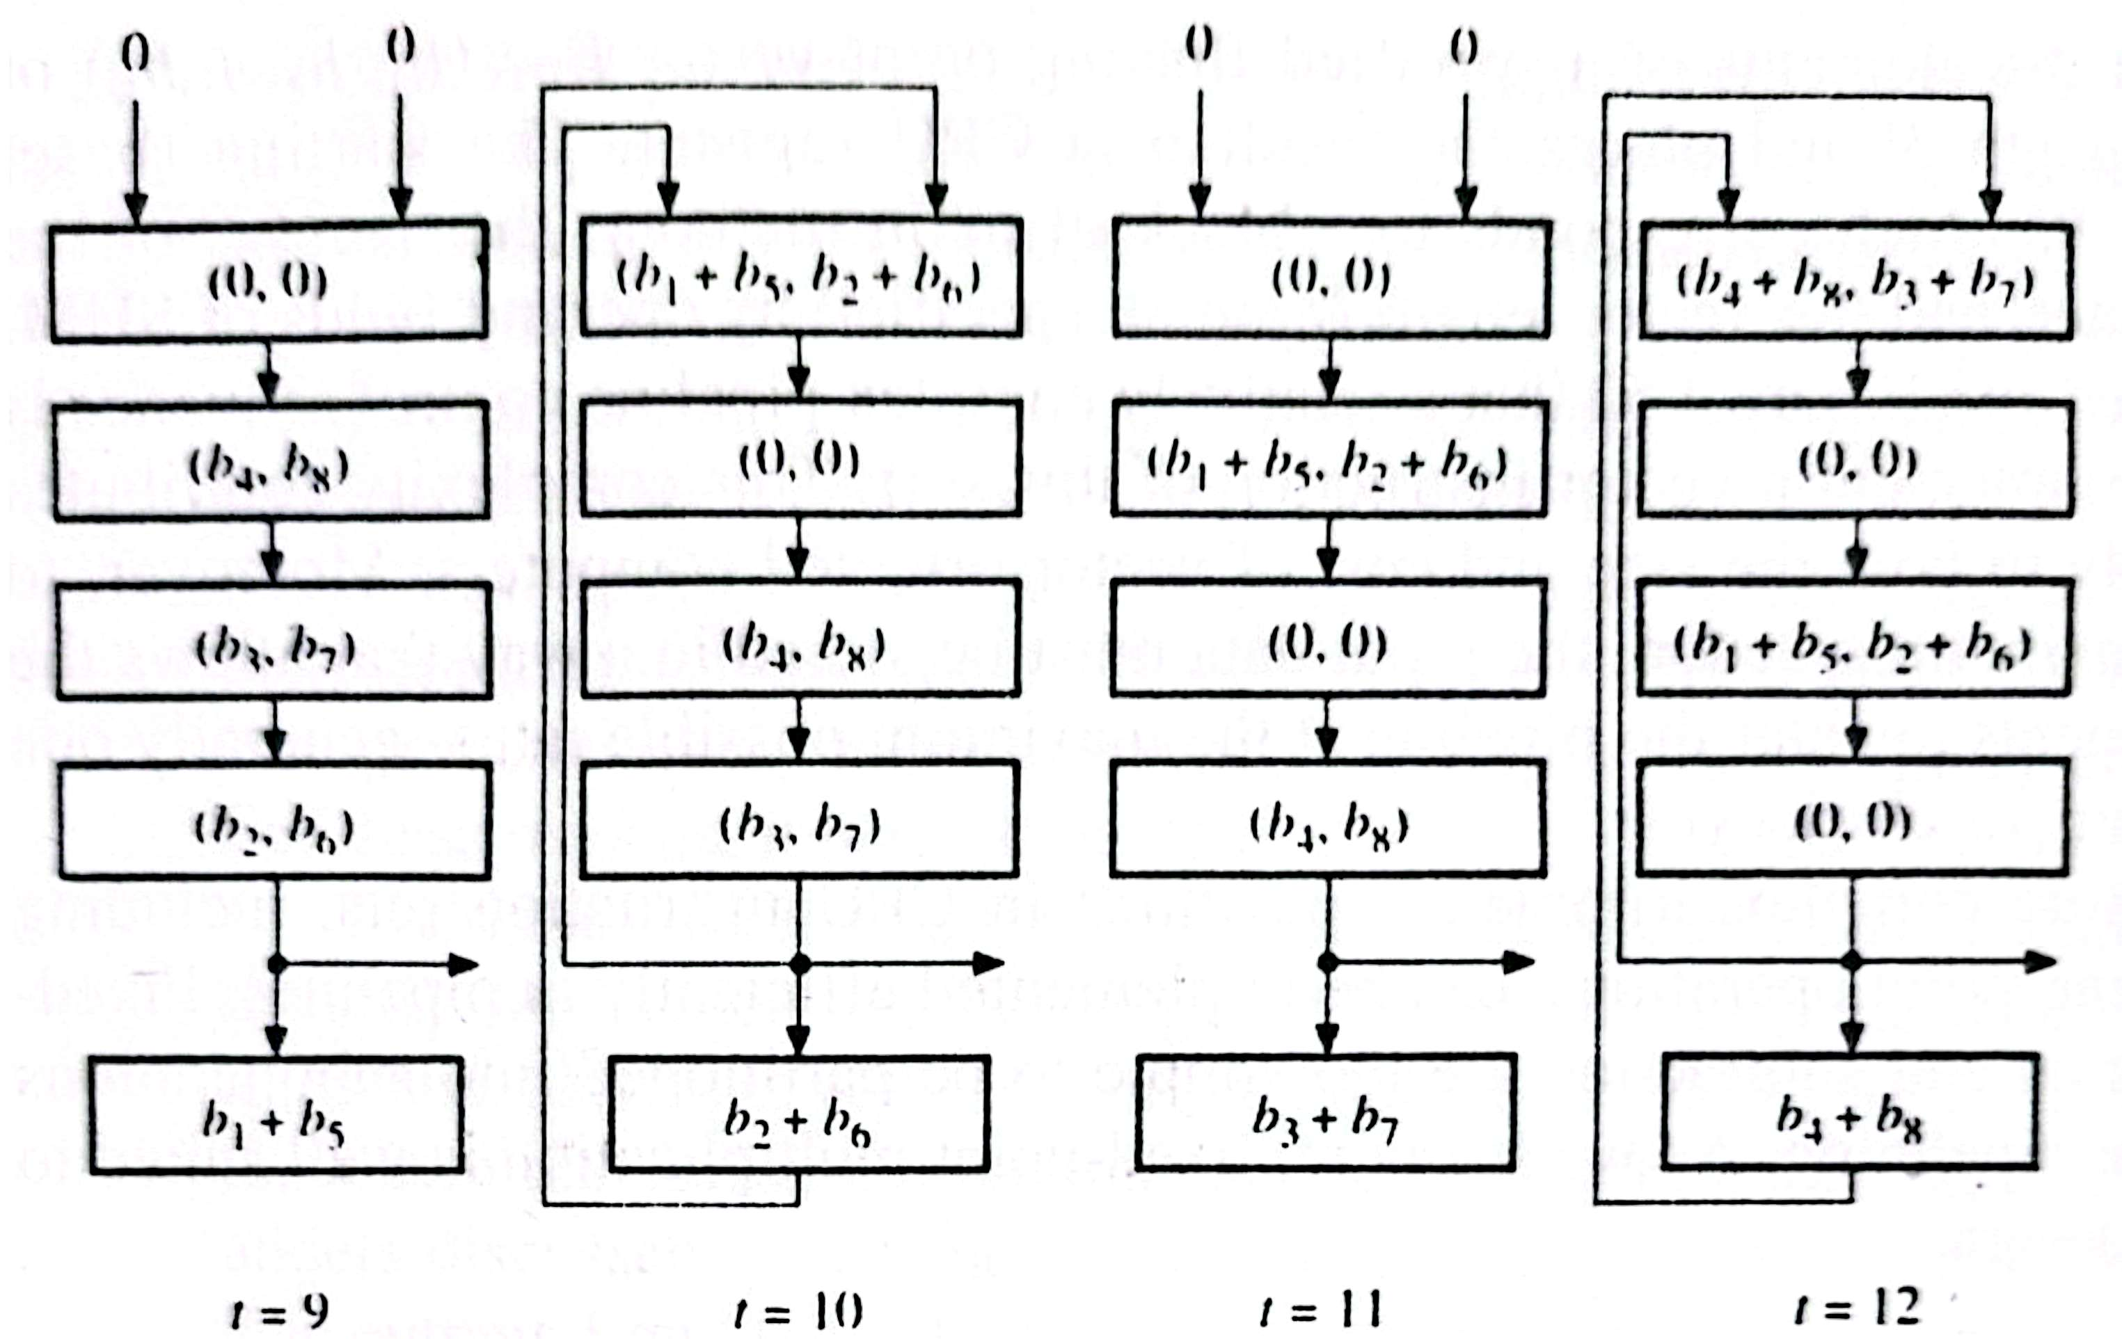
Summation by a Pipeline Processor

Slide 7
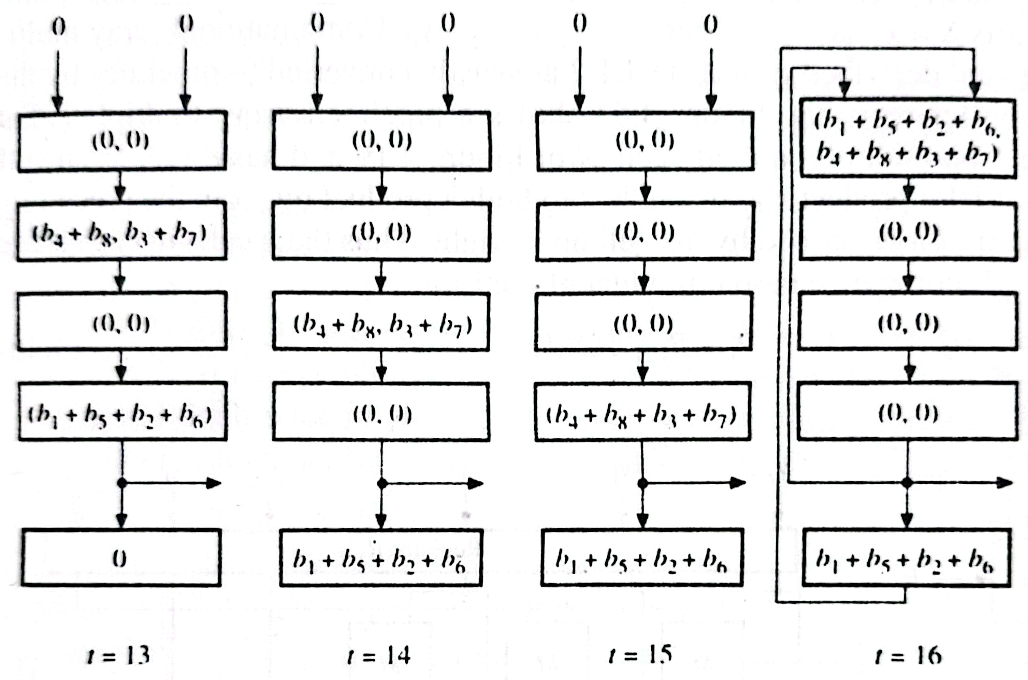
Summation by a Pipeline Processor

Slide 8
Summation by a Pipeline Processor
The final result is produced four time periods later – at t=20 in the case of N=8.
The general case of N (N>4) operands, it takes (N+12)T time, where T is the pipeline’s clock period.
For nonpipelined adder it requires time 4NT to compute the sum.
So the speedup is S(N) = 4N / (N+12).
For large N, S(4) ≈ 4.

Slide 9
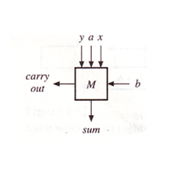
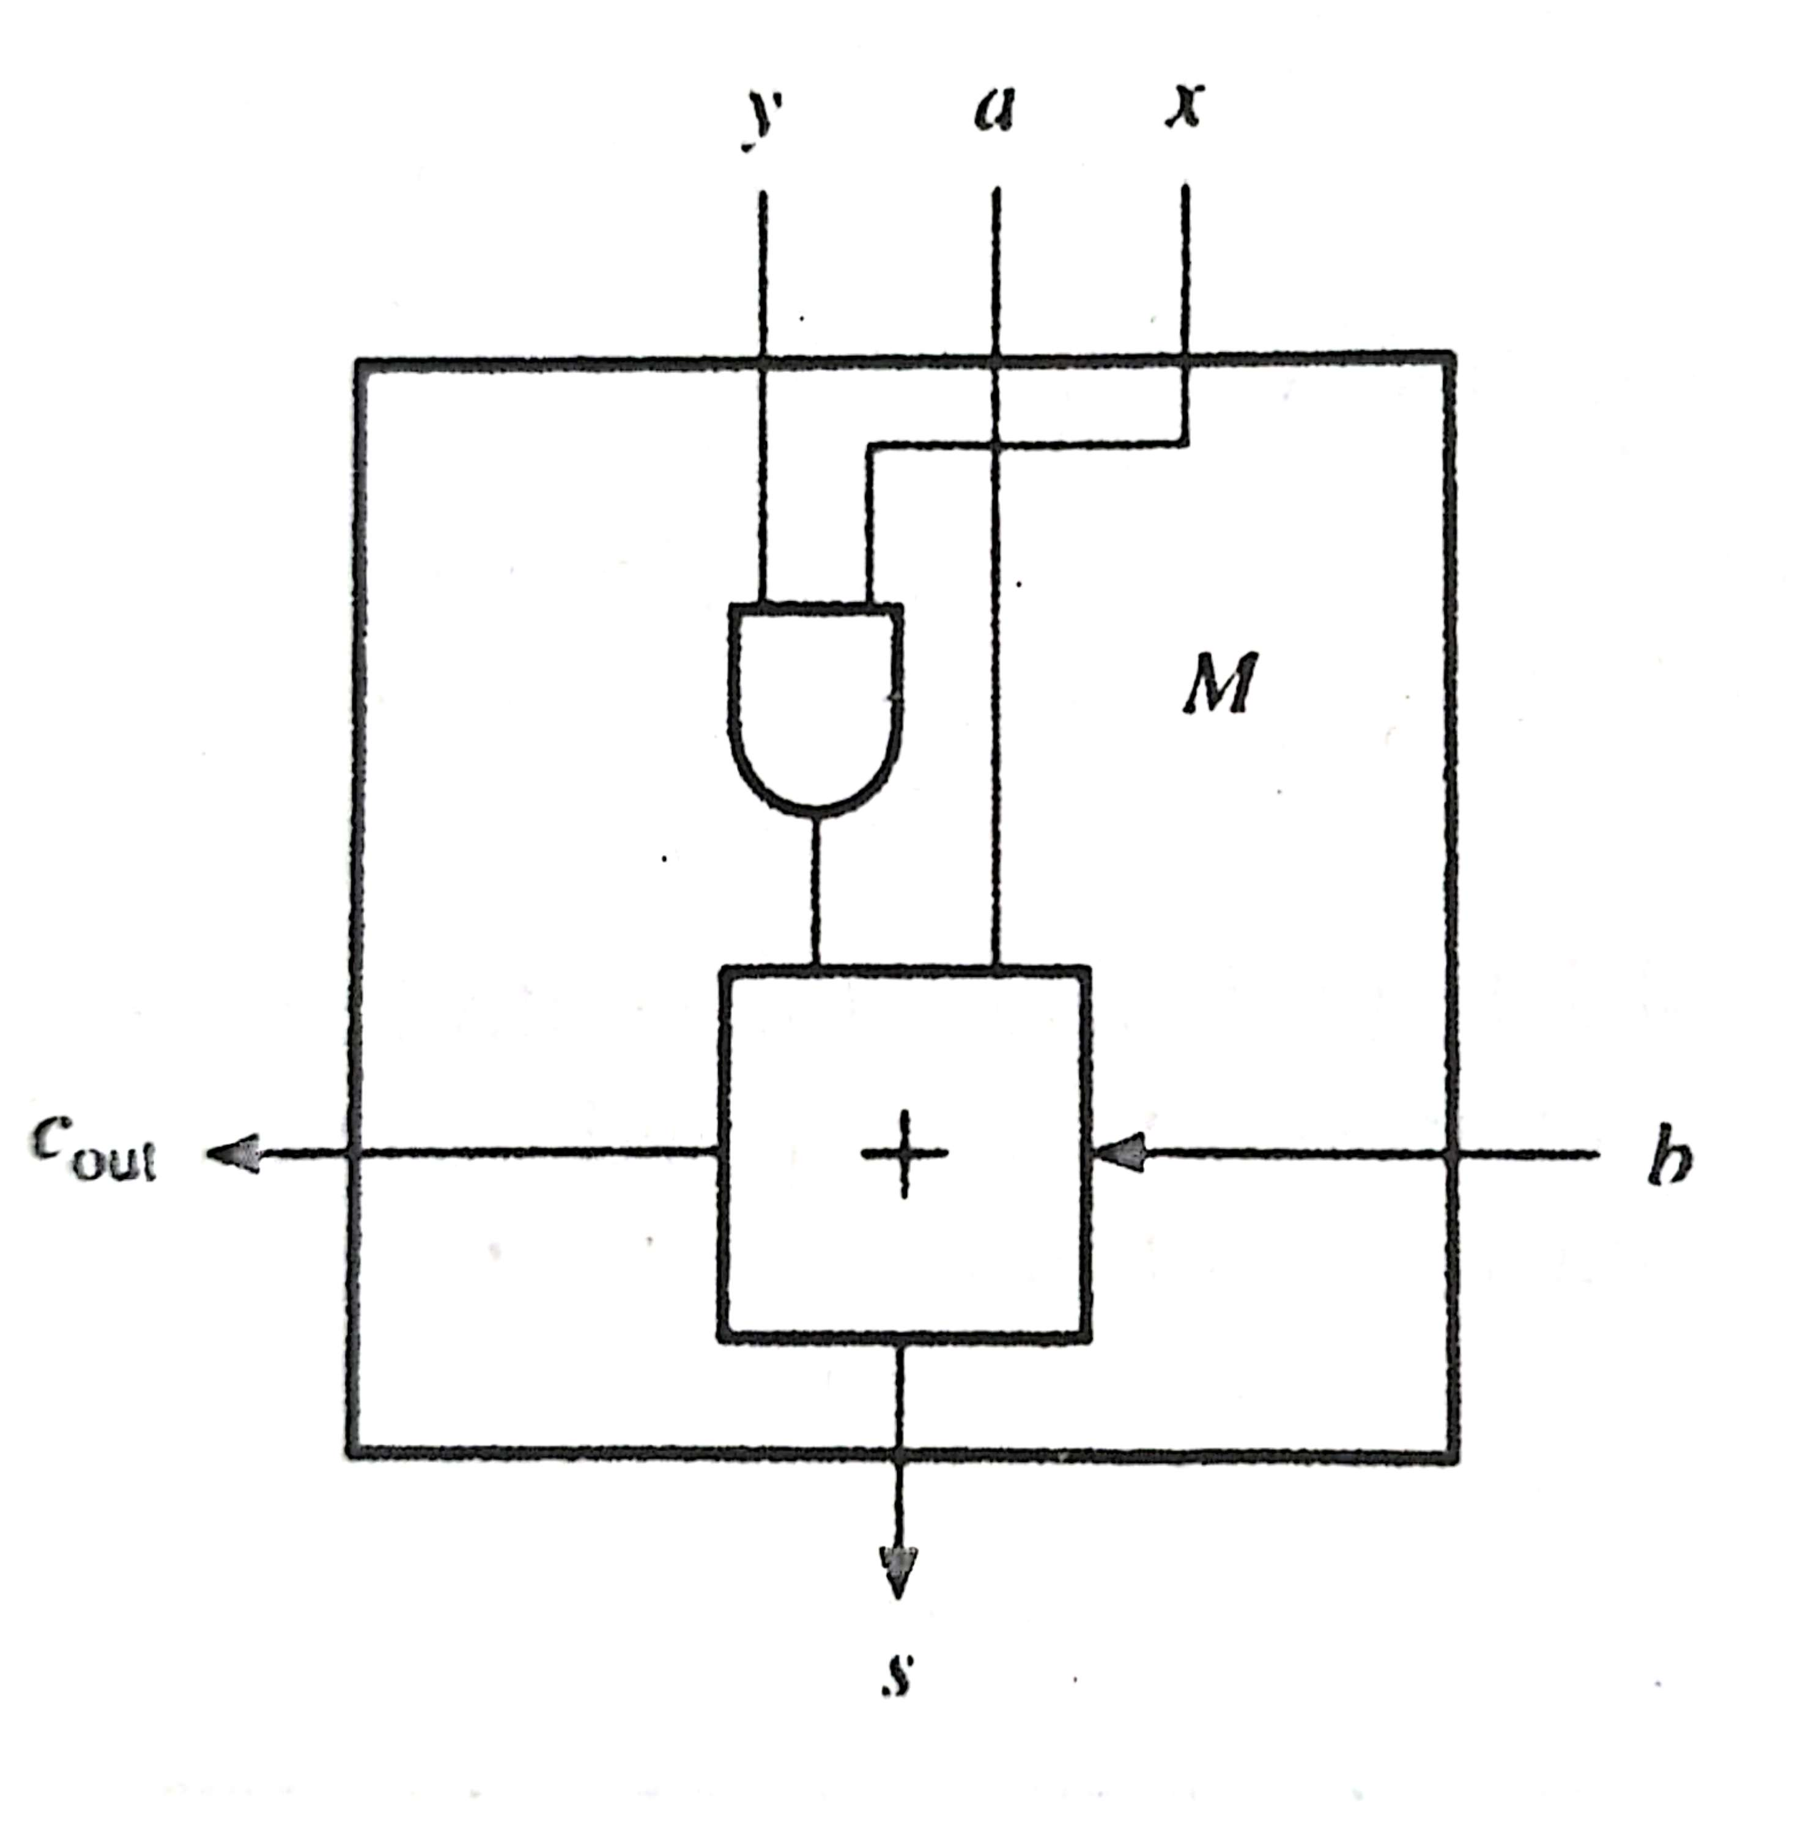
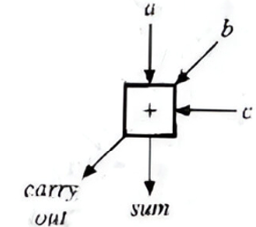
Pipelined Multiplier
A pipelined array multiplier employs the 1-bit multiply and add cell M.
Each cell M computes product bit and add it to both a product bit preceding the stage and a carry bit generated by the cell on its right.

Slide 10
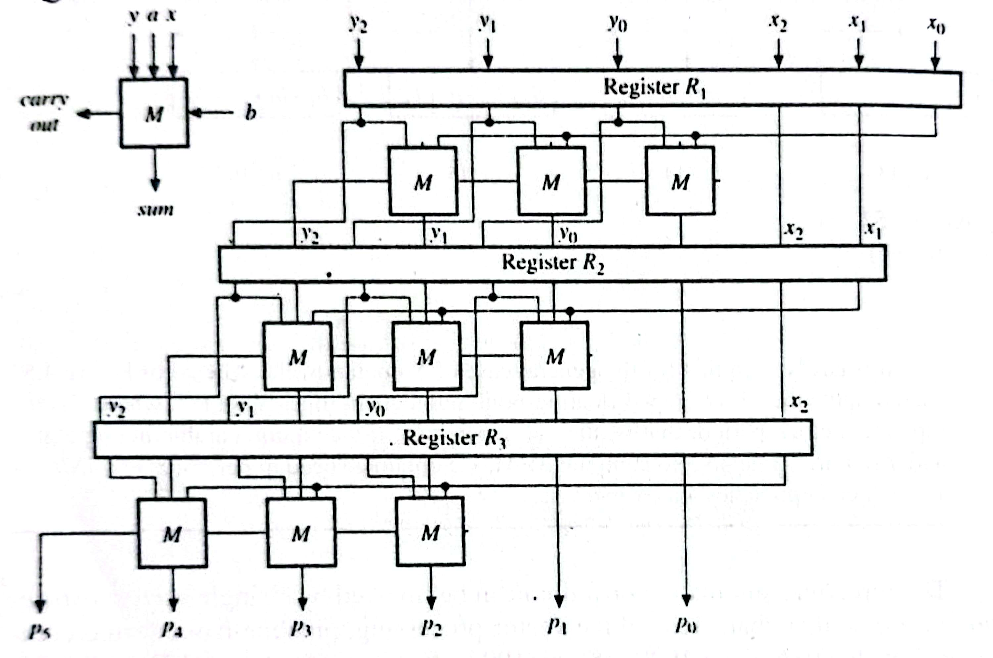
Pipelined Multiplier
Multiply two n-bit fixed point numbers binary numbers
x = x_{n-1}, x_{n-2}, …….., x₁, x₀ and y = y_{n-1}, y_{n-2}, …….., y₁, y₀
Here n =3.
C_{out}S = a plus b plus xy

Slide 11
Pipelined Multiplier
The circuit is designed for n = 3.
The M cell computes C_{out}S = a plus b plus xy
The n cells in each stage S_{i}, 0<=i<=n computes the partial product of the form P_{i} = P_{i-1} + x_{i}2^{i}Y
Buffer register R_{i} stores the partial product, the multiplicand Y and the unused multiplier bits.

Slide 12
Advantages of Pipelined Multiplier
An n-stage multiplier pipeline can overlap the computation of n separate products.
It generates a new result every clock cycle, after the delay of the pipeline.

Slide 13
Disadvantages of Pipelined Multiplier
Slow speed of the carry propagation in each stage.
The number of M cells needed in n².
The capacity of all the buffer registers is approximately 3n².
It is costly in hardware.

Slide 14
Carry Save Addition
An n-bit carry save adder consists of n disjoint full adders. It’s input is three n-bit numbers to be added and the output consists of the n-sum bits forming a word S and the n carry bits forming a word C.
Carry connections are shifted to the left correspond to normal carry propagation.
To obtain the final result, S and C must be added by a conventional adder with carry propagation.

Slide 15
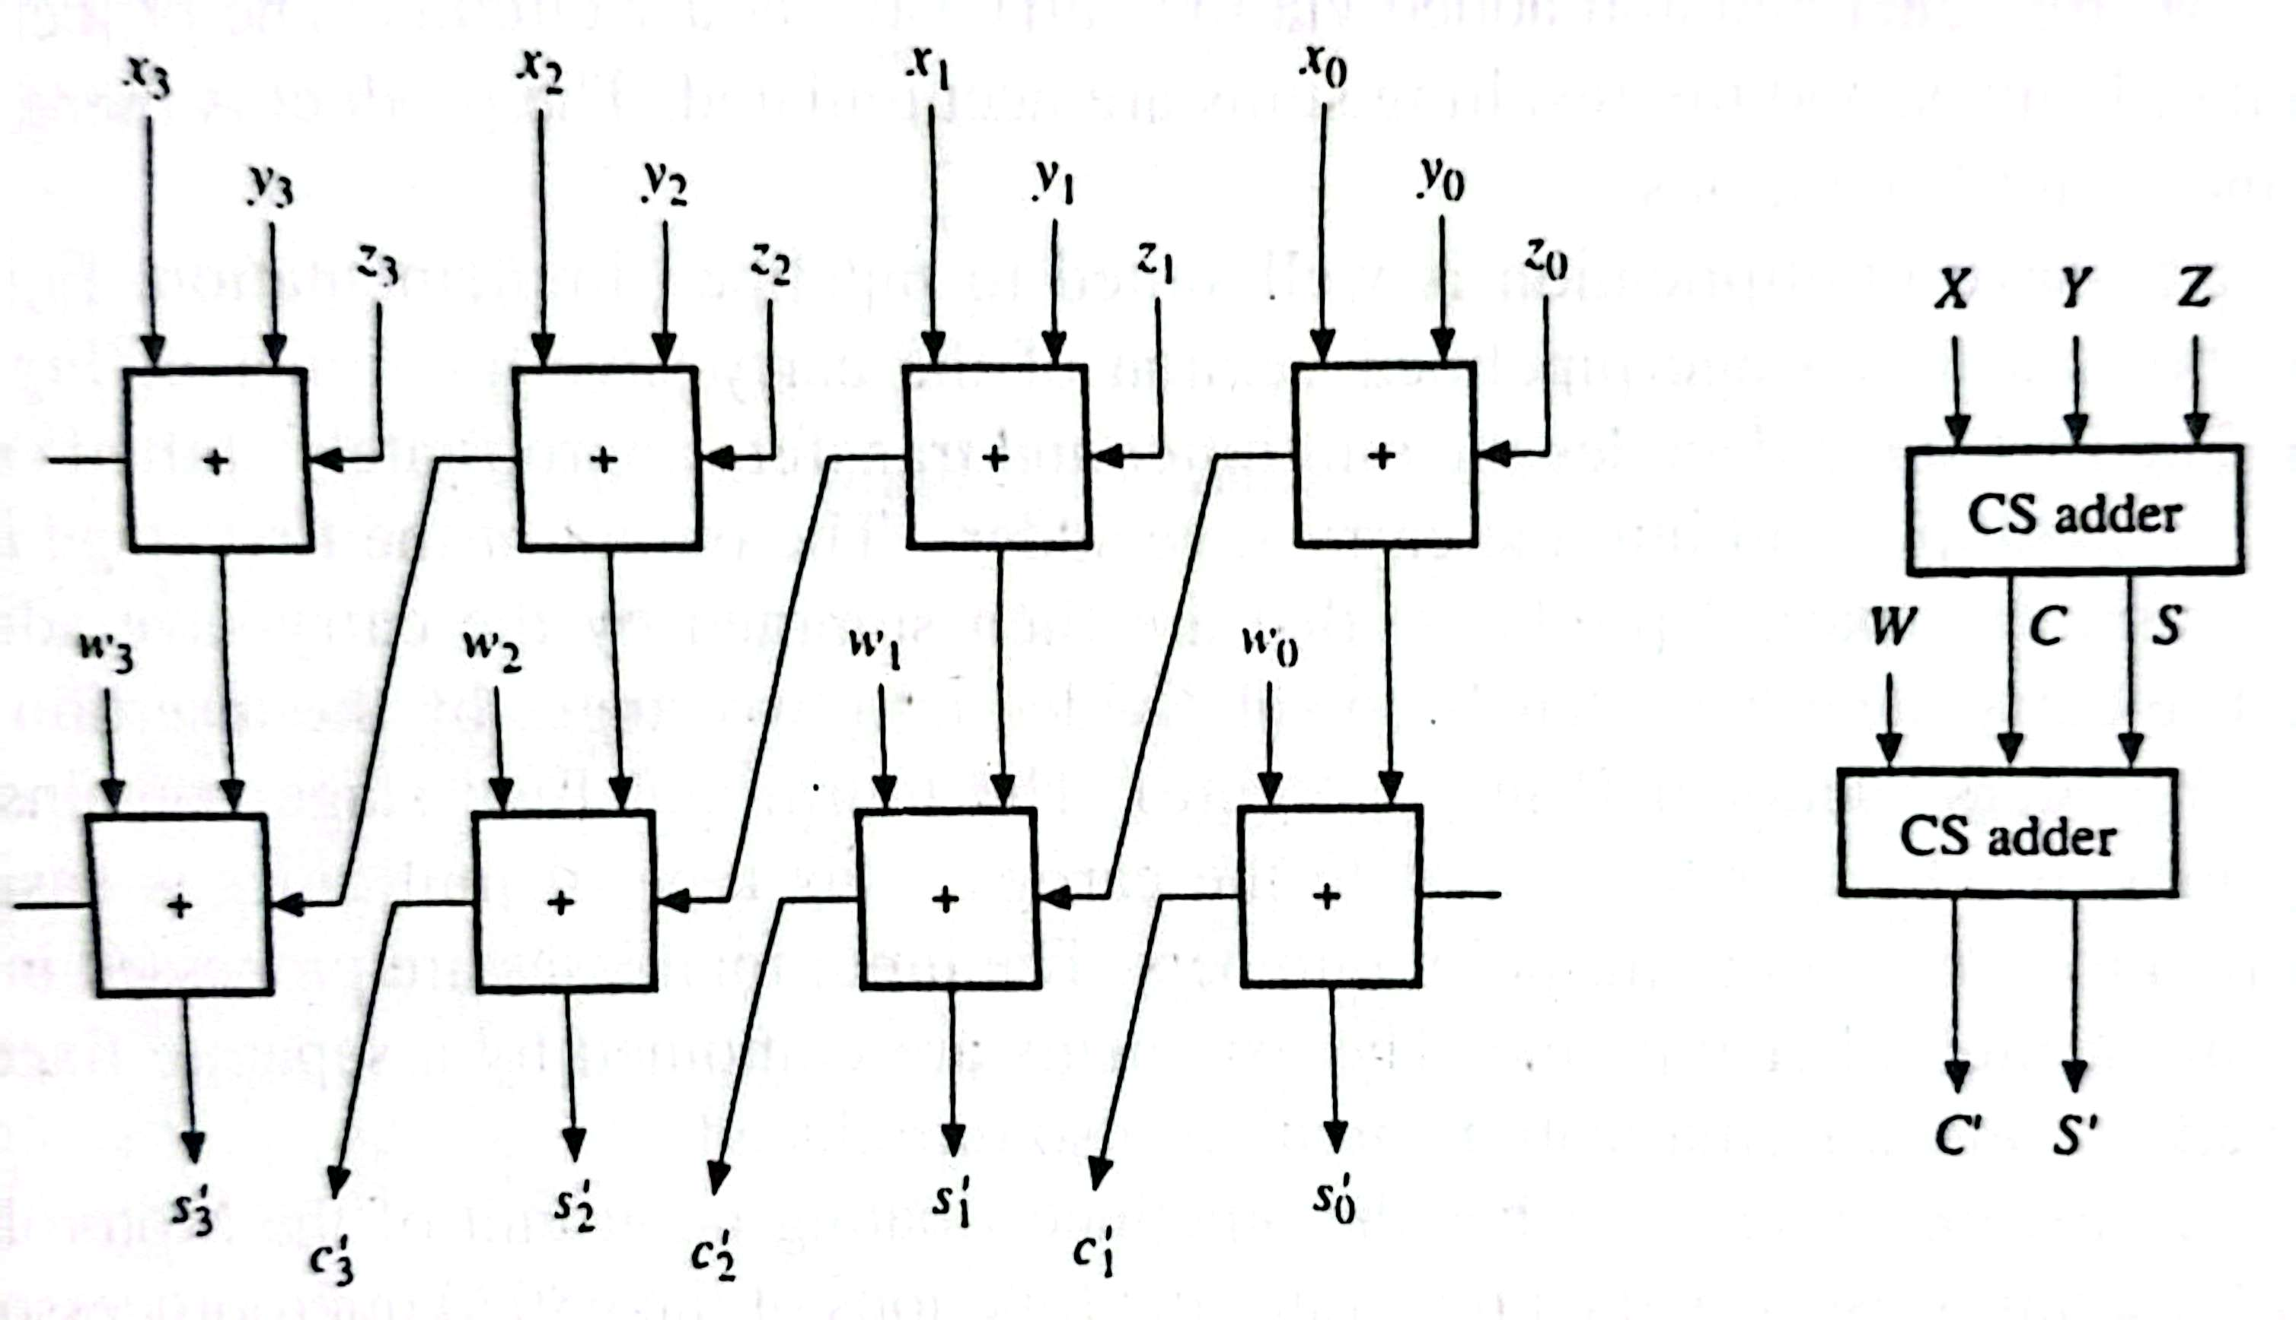
Carry Save Addition

Slide 16
Advantage of Carry Save Addition
All bits of S and C vectors are produced in a short, fixed amount of time.
Carry propagation takes place only in the second row.
Since all bits of S and C are available in parallel, a carry- lookahead adder can be used effectively to add the S and C.

Slide 17
Multiplication using Carry Save Adder
Multiplication can be performed using a multi-stage carry-save adder circuit. This circuit is called Wallace Tree.
The inputs to the adder are n-terms of the form M_{i} = x_{i}Y2^{k} where M_{i} represents multiplicand Y multiplied by the i^{th} multiplier bit weighted by power of 2.
This sum is computed by the carry-save adder tree, which produces a 2n-bit sum and a 2n-bit carry word.
The final carry assimilation is performed by a carry-lookahead adder.

Slide 18
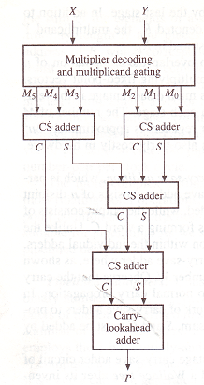
A Carry Save Multiplier

Slide 19
A Carry Save Multiplier
It is practical for moderate values of n.
For large n, the number of carry-save adders required can be excessive.
Carry-save techniques can still be used, if the multiplier is partitioned into k m-bit segments. Only m terms M_{i} are generated and added via the carry-save adder circuits.
The process is repeated k times, and the resulting sums are accumulated. The result is obtained after k iterations.

Slide 20
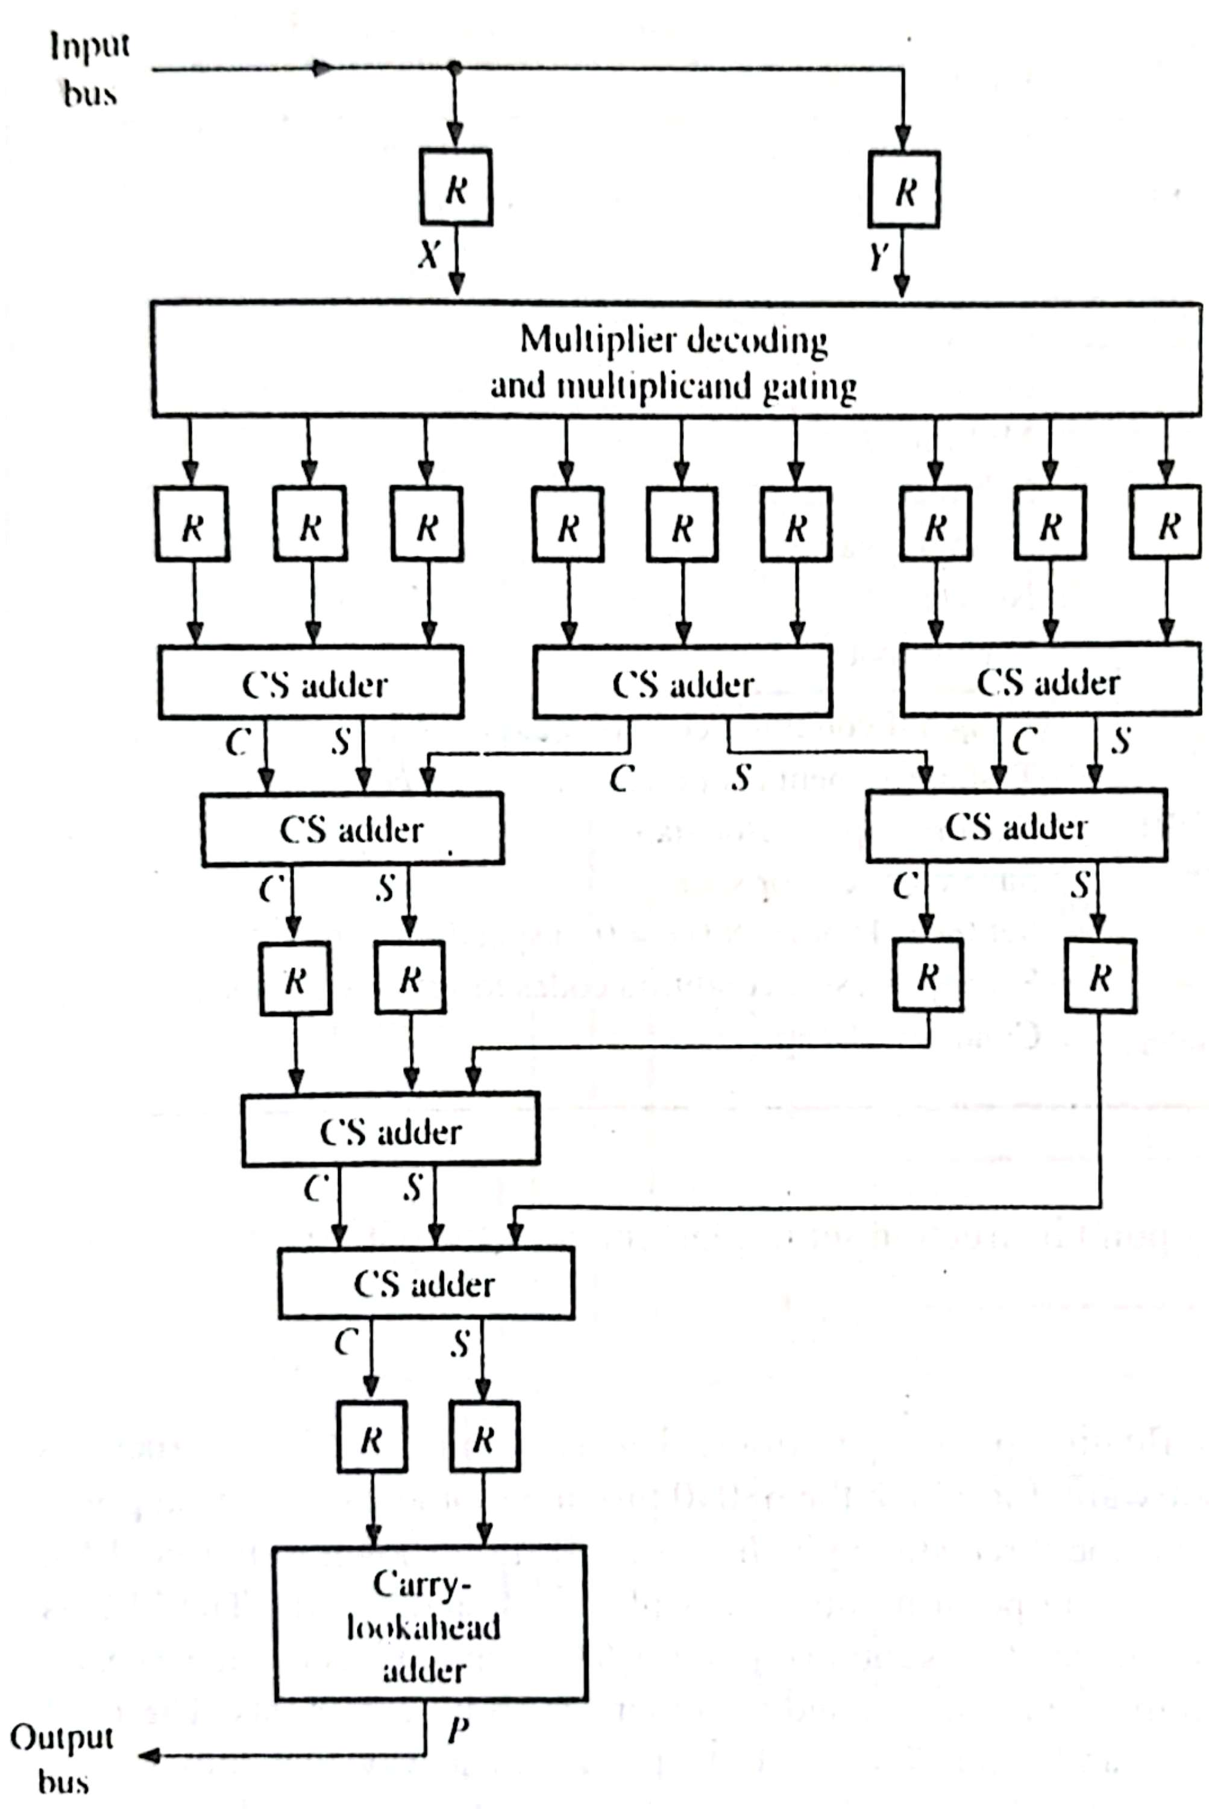
A Pipelined Carry Save Multiplier

Slide 21
Systolic Array
It is formed by interconnecting a set of identical data-processing cells in uniform manner.
Data words flow synchronously from cell to cell and each cell performs a small step in the overall operation of the array.
It permits data to flow through the cells in several directions at once.
One dimensional systolic array is therefore a kind of pipeline with identical stages.
It can used to implement various complex arithmetic operations such as matrix multiplication

Slide 22
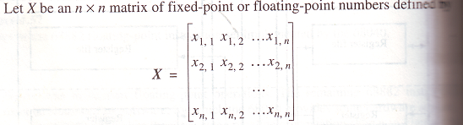

Two Dimensional Systolic Array Performing Matrix Multiplication

Slide 23
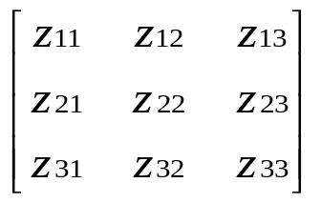
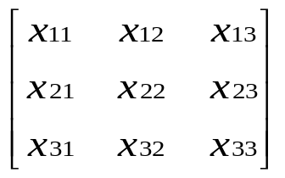
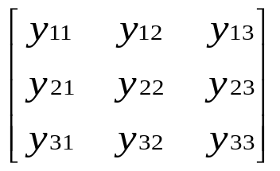
Two Dimensional Systolic Array Performing Matrix Multiplication
=
*
z₁₁ = x₁₁y₁₁ + x₁₂y₂₁ + x₁₃y₃₁
Z₁₂ = x₁₁y₁₂ + x₁₂y₂₂ + x₁₃y₃₂
Z₁₃ = x₁₁y₁₃ + x₁₂y₂₃ + x₁₃y₃₃

Slide 24
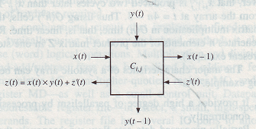
Two Dimensional Systolic Array Performing Matrix Multiplication
Each cell C_{i,j} of the matrix multiplier receives its x and y. It computes z and propagates its x and y input operands.

Slide 25
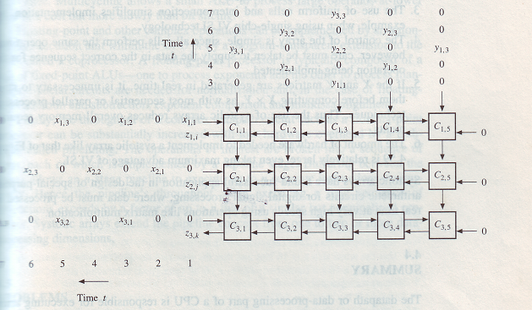
Two Dimensional Systolic Array Performing Matrix Multiplication

Slide 26
Two Dimensional Systolic Array Performing Matrix Multiplication
The systolic matrix multiplier is constructed from n(2n-1) copies of C_{i,j}.
The x and y operands are carefully ordered and separated by 0 so that the specific operand pairs x_{i,k} , y_{k,j} meet at an appropriate cell of the array.
The z’s emerge from the left side of C_{i,j}.
Each row of cells eventually issues the corresponding row of the matrix product Z from its left side.

Slide 27
Major Characteristics of A Systolic Array
Provides a higher degree of parallelism.
Partially processed data flow synchronously through the array in pipeline fashion but in several directions at once, with complete results eventually appearing at the array boundary.
The use of uniform cells and interconnection simplifies the implementation, when using single chip.
The control is simple. But care must be taken to supply the data in the correct sequence.
X and Y need not to store before computing X × Y.
The amount of hardware needed to implement is relatively large.

